Slide 1
Identity, Access, and Security

Slide 2
Identity, Access, and Security - Objective Domain
Describe the benefits and usage of:
Describe directory services in Azure, including Azure Active Directory (AD) and Azure AD DS, part of Microsoft Entra.
Describe authentication methods in Azure, including single sign-on (SSO), multifactor authentication (MFA), and passwordless.
Describe external identities and guest access in Azure.
Describe Azure AD Conditional Access.
Describe Azure Role Based Access Control (RBAC).
Describe the concept of Zero Trust.
Describe the purpose of the defense in depth model.
Describe the purpose of Microsoft Defender for Cloud.
Notes:
https://docs.microsoft.com/learn/modules/describe-azure-identity-access-security/1-introduction

Slide 3
Active Directory Domain Services (AD DS)
AD DS and its related services form the foundation for enterprise networks that run Windows operating systems.
The AD DS database is the central store of all the domain objects, such as user accounts, computer accounts, and groups.
AD DS provides a searchable, hierarchical directory and a method for applying configuration and security settings for objects in an enterprise.
In addition, you can use AD DS options to perform actions such as:
Installing, configuring, and updating apps.
Managing the security infrastructure.
Enabling Remote Access Service and DirectAccess.
Issuing and managing digital certificates.
Notes:
Define AD DS - Training | Microsoft Learn

Slide 4
Define AD DS
AD DS is composed of both logical and physical components
Logical components
Partitions
Schema
Domains
Domain trees
Forests
Sites
OUs
Containers
Physical components
Domain controllers
Data stores
Global catalog servers
RODCs
Notes:
Learn – https://docs.microsoft.com/en-us/learn/modules/introduction-to-ad-ds/2-define-ad-ds

Slide 5
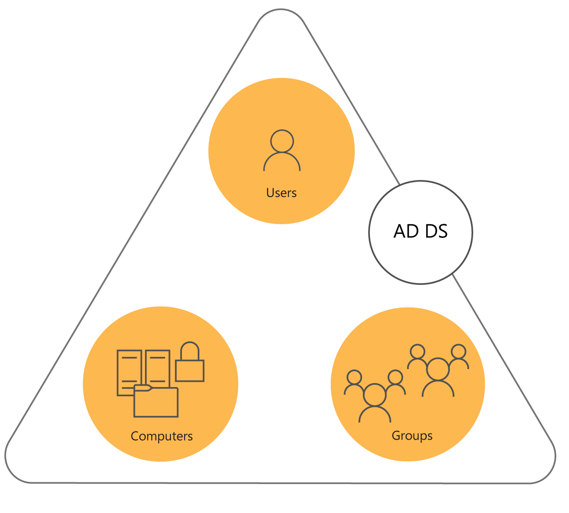
What is an AD DS domain?
AD DS domain is logical container for managing user, computer, group, and other objects
AD DS domain is often described as:
A replication boundary
An administrative unit
An AD DS domain provides:
Authentication
Authorization
Notes:
Learn - https://docs.microsoft.com/en-us/learn/modules/introduction-to-ad-ds/4-define-forests-domains
Explain the relationships among the forest root domain, a child domain, and another tree. Emphasize that there is no administrative difference between the child domain and the other tree, apart from the names.
Suggest you use the whiteboard to record a typical multidomain, or even a multiforest, AD DS environment. Identify the types of trusts on your diagram.
Types of trust
Parent and child
Tree-root
External
Realm
Forest
Shortcut

Slide 6
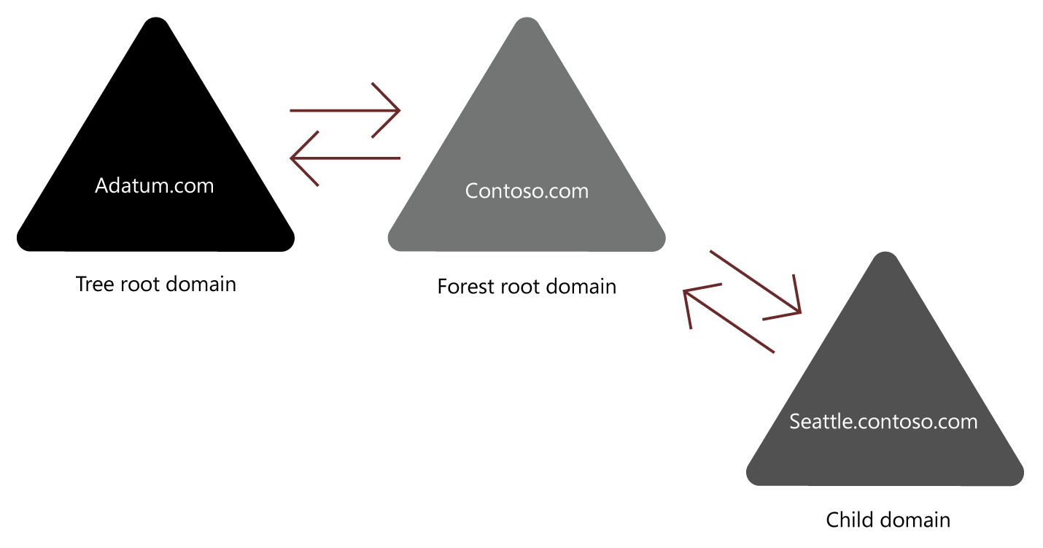
What is an AD DS forest?
A Forest is a top-level container in AD DS
AD DS forest often described as:
Security boundary
A replication boundary
Trust relationships
Provide access to resources in a complex AD DS environment
Notes:
Learn - https://docs.microsoft.com/en-us/learn/modules/introduction-to-ad-ds/4-define-forests-domains
An AD DS forest is a collection of one or more AD DS trees that contain one or more AD DS domains. Domains in a forest share:
A common root.
A common schema.
A global catalog.
An AD DS domain is a logical administrative container for objects such as:
Users
Groups
Computers
The following objects exist in the forest root domain:
The schema master role.
The domain naming master role.
The Enterprise Admins group.
The Schema Admins group.
The following objects exist in each domain (including the forest root):
The RID master role.
The Infrastructure master role.
The PDC emulator master role.
The Domain Admins group.

Slide 7
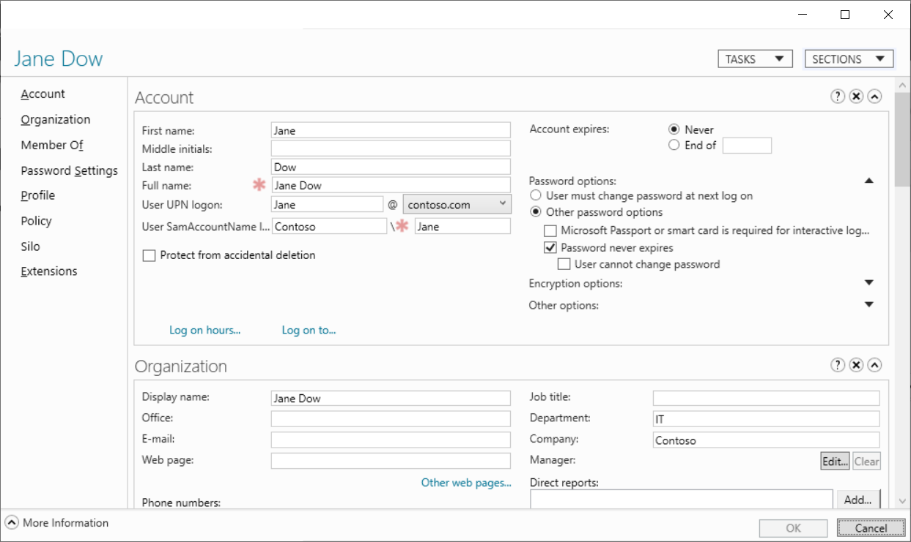
Define user objects
Create user objects
A user account includes:
The username
A user password
Group memberships
Notes:
Learn - https://docs.microsoft.com/en-us/learn/modules/introduction-to-ad-ds/3-define-users-groups-computers
Consider demonstrating these object types (and those described in the next few slides) as you discuss them.

Slide 8
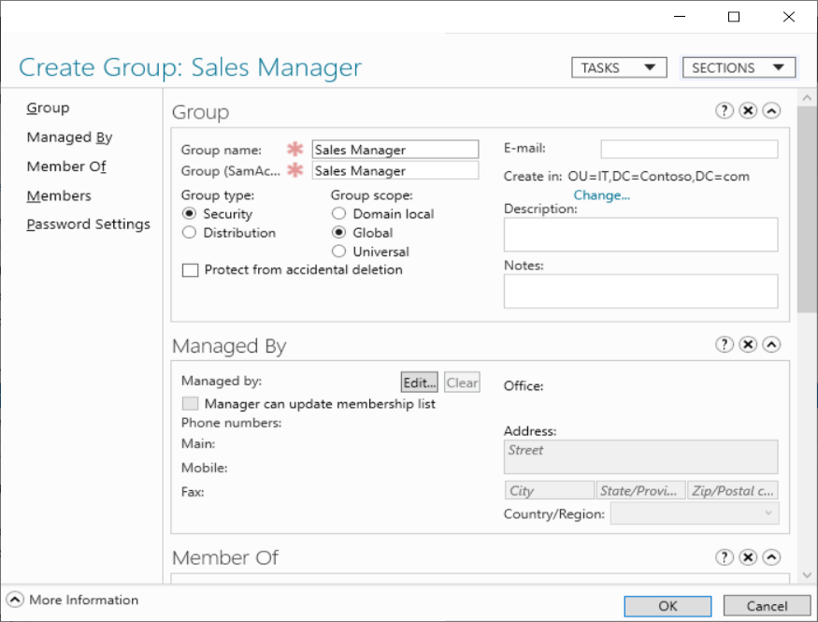
Define group objects
What are group objects?
Group types
Security
Distribution
Group scopes
Local
Domain-local
Global
Universal
Notes:
Learn - https://docs.microsoft.com/en-us/learn/modules/introduction-to-ad-ds/3-define-users-groups-computers

Slide 9
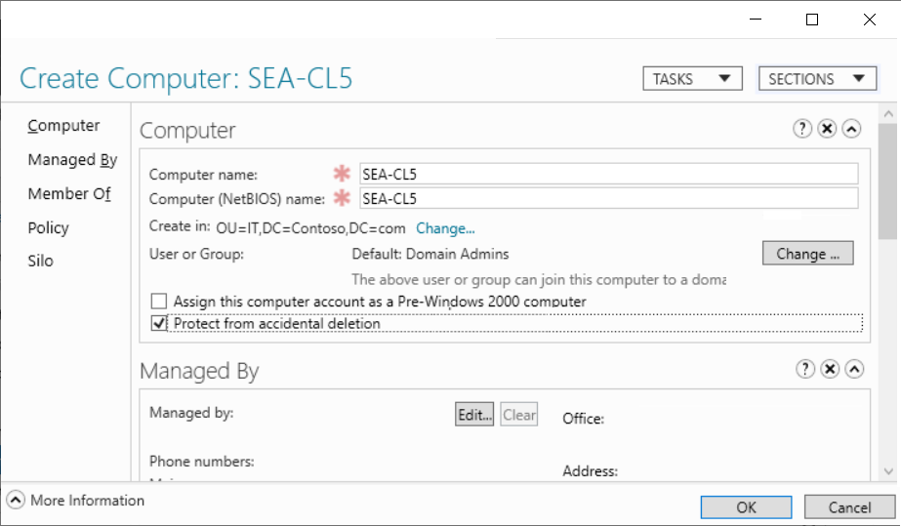
Define computer objects
Computers are security principals:
They have an account with a sign-in name and password.
They authenticate with the domain.
They can belong to groups and have access to resources
Notes:
Learn - https://docs.microsoft.com/en-us/learn/modules/introduction-to-ad-ds/3-define-users-groups-computers
What are computer objects?
Computers, like users, are security principals, in that:
They have an account with a sign-in name and password that Windows changes automatically on a periodic basis.
They authenticate with the domain.
They can belong to groups and have access to resources, and you can configure them by using Group Policy.
A computer account begins its lifecycle when you create the computer object and join it to your domain. After you join the computer account to your domain, day-to-day administrative tasks include:
Configuring computer properties.
Moving the computer between OUs.
Managing the computer itself.
Renaming, resetting, disabling, enabling, and eventually deleting the computer object.
Computers container
Before you create a computer object in AD DS, you must have a place to put it. The Computers container is a built-in container in an AD DS domain. This container is the default location for the computer accounts when a computer joins the domain.
This container is not an OU. Instead, it is an object of the Container class. Its common name is CN=Computers. There are subtle but important differences between a container and an OU. You cannot create an OU within a container, so you cannot subdivide the Computers container. You also cannot link a Group Policy Object to a container. Therefore, we recommend that you create custom OUs to host computer objects, instead of using the Computers container.

Slide 10
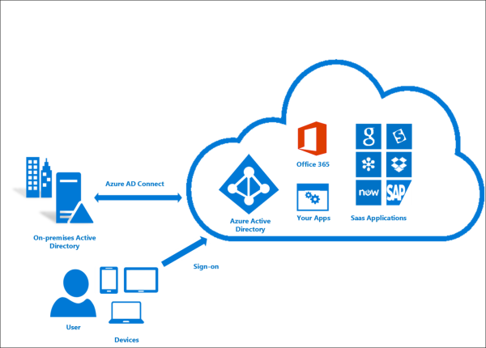
Azure AD Connect (original sync technology)
Azure AD Connect provides the following features:
Password Hash Sync
User, Groups Synchronization etc.
Ensures identity information for your on-premises users and groups is matching the cloud
Notes:
What is Azure AD Connect cloud sync? - Microsoft Entra | Microsoft Learn

Slide 11
Azure AD Connect Cloud Sync
Azure AD Connect cloud sync is a new offering from Microsoft designed to meet and accomplish your hybrid identity goals for synchronization of users, groups, and contacts to Azure AD.
It accomplishes this by using the Azure AD cloud provisioning agent instead of the Azure AD Connect application.
Notes:
What is Azure AD Connect and Connect Health. - Microsoft Entra | Microsoft Learn
What is Azure AD Connect cloud sync? - Microsoft Entra | Microsoft Learn

Slide 12

Azure Active Directory (AAD)
Azure Active Directory (AAD) is Microsoft Azure’s cloud-based identity and access management service.
Authentication (employees sign-in to access resources).
Single sign-on (SSO).
Application management:
Business to Business (B2B).
Business to Customer (B2C) identity services.
Device management.
Notes:
https://docs.microsoft.com/learn/modules/describe-azure-identity-access-security/2-directory-services
Azure AD - https://azure.microsoft.com/en-us/services/active-directory/
Azure tenant
A dedicated and trusted instance of Azure AD that's automatically created when your organization signs up for a Microsoft cloud service subscription, such as Microsoft Azure, Microsoft Intune, or Office 365. An Azure tenant represents a single organization.
Azure AD directory
Each Azure tenant has a dedicated and trusted Azure AD directory. The Azure AD directory includes the tenant's users, groups, and apps and is used to perform identity and access management functions for tenant resources.
Application Management: What is application management? - Microsoft Entra | Microsoft Learn

Slide 13
AAD Services
Authentication: This includes verifying identity to access applications and resources. It also includes providing functionality such as self-service password reset, multifactor authentication, a custom list of banned passwords, and smart lockout services.
Single sign-on: Single sign-on (SSO) enables you to remember only one username and one password to access multiple applications. A single identity is tied to a user, which simplifies the security model. As users change roles or leave an organization, access modifications are tied to that identity, which greatly reduces the effort needed to change or disable accounts.
Application management: You can manage your cloud and on-premises apps by using Azure AD. Features like Application Proxy, SaaS apps, the My Apps portal, and single sign-on provide a better user experience.
Device management: Along with accounts for individual people, Azure AD supports the registration of devices. Registration enables devices to be managed through tools like Microsoft Intune. It also allows for device-based Conditional Access policies to restrict access attempts to only those coming from known devices, regardless of the requesting user account.
Notes:
Describe Azure directory services - Training | Microsoft Learn

Slide 14
AAD Application Management
Application management in Azure Active Directory (Azure AD) is the process of creating, configuring, managing, and monitoring applications in the cloud.
When an application is registered in an Azure AD tenant, users who have been assigned to it can securely access it.
Notes:
What is application management? - Microsoft Entra | Microsoft Learn

Slide 15
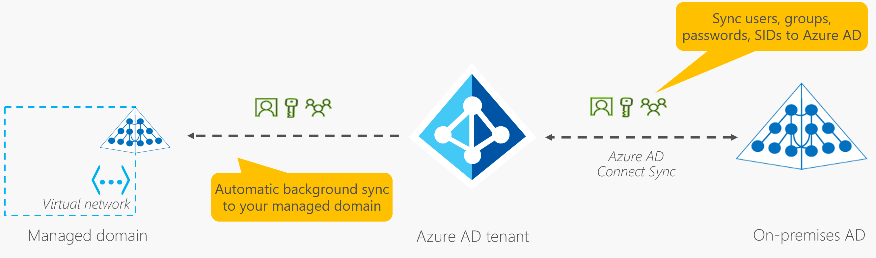
Azure Active Directory Domain Services (Azure AD DS)
Gain the benefit of cloud-based domain services without managing domain controllers
Run legacy applications (that can’t use modern auth standards) in the cloud
Automatically sync from Azure AD
Notes:
https://docs.microsoft.com/learn/modules/describe-azure-identity-access-security/2-directory-services
Azure AD - https://azure.microsoft.com/en-us/services/active-directory/

Slide 16
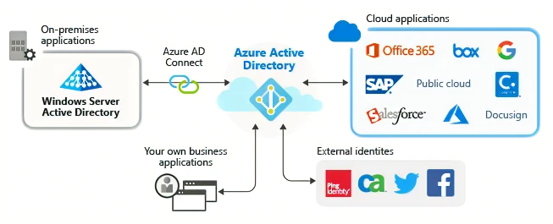

Slide 17



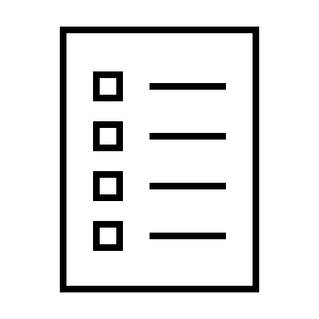
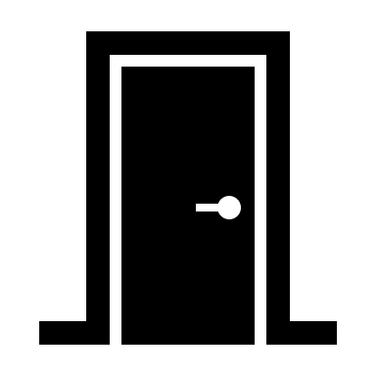




Compare Authentication and Authorization
Authentication
Identifies the person or service seeking access to a resource.
Requests legitimate access credentials.
Basis for creating secure identity and access control principles.
Authorization
Determines an authenticated person’s or service’s level of access.
Defines which data they can access, and what they can do with it.
Notes:
https://docs.microsoft.com/learn/modules/describe-azure-identity-access-security/3-authentication-methods
✔️Authentication is sometimes shortened to AuthN, and authorization is sometimes shortened to AuthZ.
Authentication
Identifies the person or service seeking access to a resource.
Requests legitimate access credentials.
Basis for creating secure identity and access control principles.
Authorization
Determines an authenticated person’s or service’s level of access.
Defines which data they can access, and what they can do with it.

Slide 18
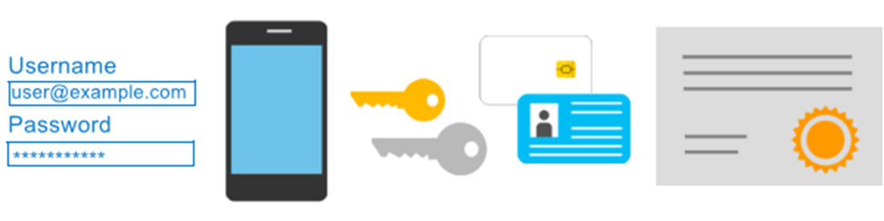
Azure Multi-Factor Authentication
Provides additional security for your identities by requiring two or more elements for full authentication.
Something you know ←→ Something you possess ←→ Something you are
Notes:
https://docs.microsoft.com/learn/modules/describe-azure-identity-access-security/3-authentication-methods
Discuss what could qualify for each of the items listed
Something you know: This could be a password or the answer to a security question.
Something you possess: This might be a mobile app that receives a notification, or a token-generating device.
Something you are: This is typically some sort of biometric property, such as a fingerprint or face scan used on many mobile devices.
MFA - https://docs.microsoft.com/en-us/azure/active-directory/authentication/concept-mfa-howitworks

Slide 19
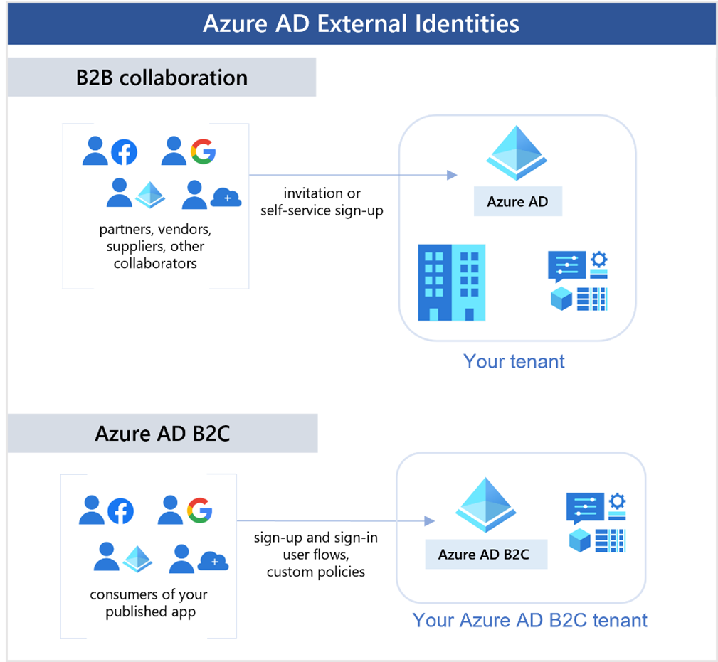
External Identities B2B
Notes:
https://docs.microsoft.com/learn/modules/describe-azure-identity-access-security/4-external-identities

Slide 20
External Identities B2C
Notes:
https://docs.microsoft.com/learn/modules/describe-azure-identity-access-security/4-external-identities

Slide 21
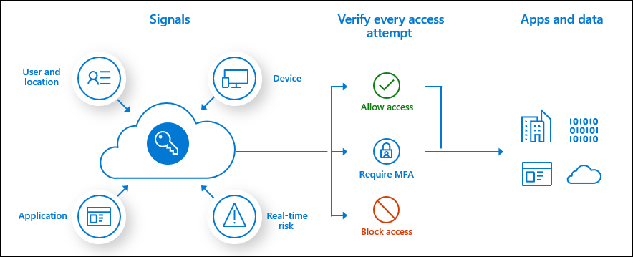
Conditional Access
Conditional Access is used by Azure Active Directory to bring signals together, to make decisions, and enforce organizational policies.
User or Group Membership
IP Location
Device
Application
Risk Detection
Notes:
https://docs.microsoft.com/learn/modules/describe-azure-identity-access-security/5-conditional-access
https://docs.microsoft.com/en-us/azure/active-directory/conditional-access/overview
The modern security perimeter now extends beyond an organization's network to include user and device identity. Organizations can utilize these identity signals as part of their access control decisions.
Conditional Access is the tool used by Azure Active Directory to bring signals together, to make decisions, and enforce organizational policies. Conditional Access is at the heart of the new identity driven control plane.
Conditional Access policies at their simplest are if-then statements, if a user wants to access a resource, then they must complete an action. Example: A payroll manager wants to access the payroll application and is required to perform multi-factor authentication to access it.
Administrators are faced with two primary goals:
Empower users to be productive wherever and whenever
Protect the organization's assets
By using Conditional Access policies, you can apply the right access controls when needed to keep your organization secure and stay out of your user's way when not needed.

Slide 22
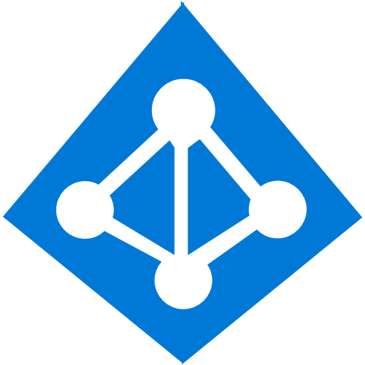




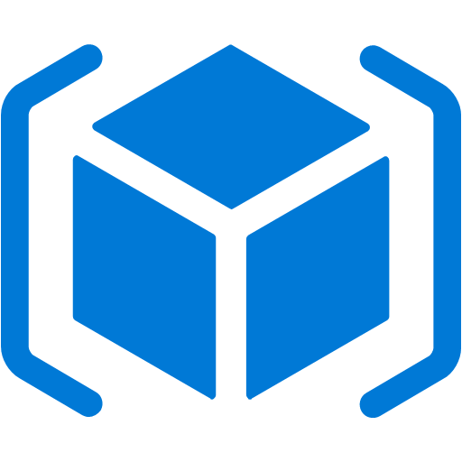
Azure role-based access control (Azure RBAC)
Fine-grained access management.
Segregate duties within the team and grant only the amount of access to users that they need to perform their jobs.
Enables access to the Azure portal and controlling access to resources.
Azure
Active Directory
Azure
subscription
User
Apps
User groups
Resource group
Resource group
Notes:
https://docs.microsoft.com/learn/modules/describe-azure-identity-access-security/6-role-based-access-control
Azure RBAC - https://docs.microsoft.com/en-us/azure/role-based-access-control/overview

Slide 23
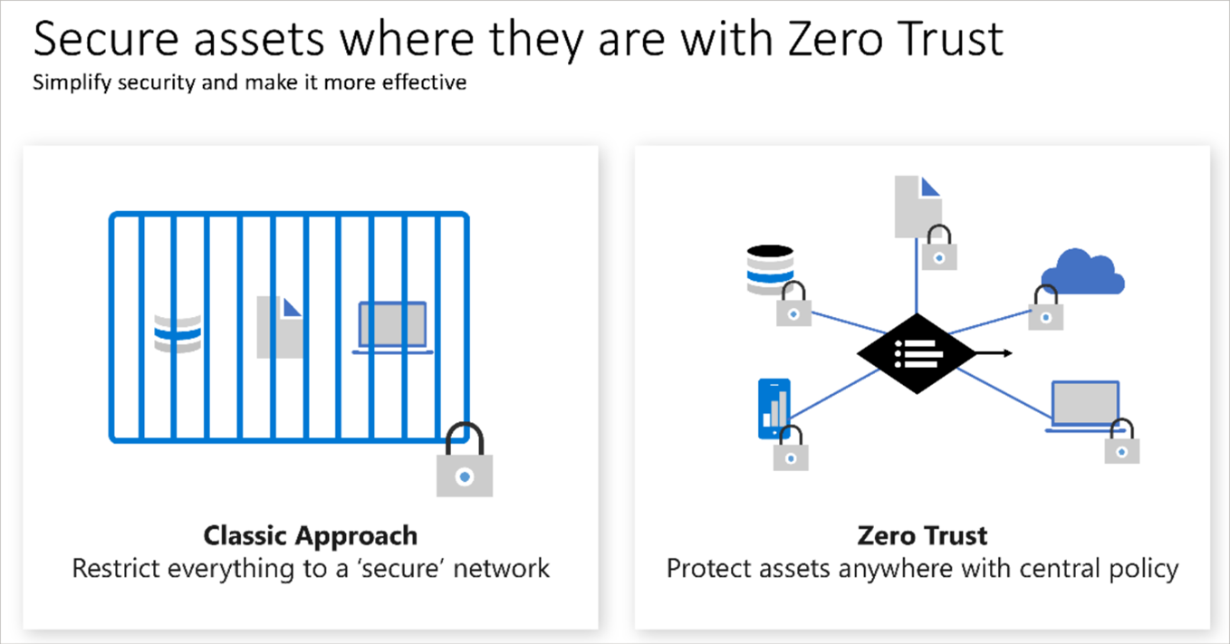
Zero Trust
Notes:
https://docs.microsoft.com/learn/modules/describe-azure-identity-access-security/7-describe-zero-trust-model

Slide 24
Defense in depth
Physical Security
A layered approach to securing computer systems.
Provides multiple levels of protection.
Attacks against one layer are isolated from subsequent layers.
Identity & Access
Perimeter
Network
Compute
Application
Data
Notes:
https://docs.microsoft.com/learn/modules/describe-azure-identity-access-security/8-describe-defense-depth

Slide 25
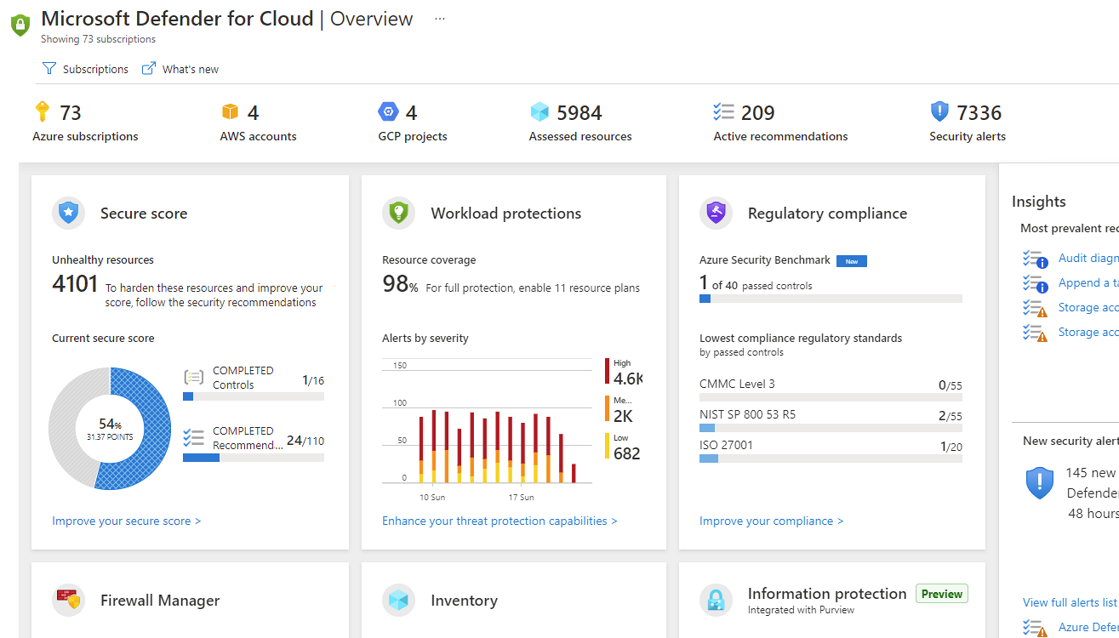
Microsoft Defender for Cloud
Microsoft Defender for Cloud is a monitoring service that provides threat protection across both Azure and on-premises datacenters.
Provides security recommendations
Detect and block malware
Analyze and identify potential attacks
Just-in-time access control for ports
Notes:
https://docs.microsoft.com/learn/modules/describe-azure-identity-access-security/9-describe-microsoft-defender-for-cloud
Microsoft Defender for Cloud is a unified infrastructure security management system that strengthens the security posture of your data centers and provides advanced threat protection across your hybrid workloads in the cloud - whether they're in Azure or not - as well as on premises.
Strengthen security posture: Defender for Cloud assesses your environment and enables you to understand the status of your resources, and whether they are secure.
Protect against threats: Defender for Cloud assesses your workloads and raises threat prevention recommendations and security alerts.
Get secure faster: In Defender for Cloud, everything is done in cloud speed. Because it is natively integrated, deployment is easy, providing you with auto-provisioning and protection with Azure services.
Policy compliance Defender for Cloud is built on top of Azure Policy controls so you can set and monitor your policies to run on management groups, across subscriptions, and even for a whole tenant.
Security alerts Defender for Cloud automatically collects, analyzes, and integrates log data from your Azure resources like firewall and endpoint protection to detect real threats. Then list of prioritized security alerts is shown in Microsoft Defender for Cloud along with the information you need to quickly investigate and remediate an attack.
Secure score Defender for Cloud continually assesses your resources for security issues; then aggregates all the findings into a single score so that you can tell your current security situation.
Microsoft Defender for Cloud - https://azure.microsoft.com/services/defender-for-cloud/

